Slide 1
Refill Operators Training

Slide 2
Issue Definition
Current Impact
Countermeasures

Slide 3
Issue Definition
After completing refill, controller is still in REFILLED state
Customers get H/W error when dispensing fuel
Customers can’t buy fuel until NOC remotely restart KP
Results from refill box hardware failure (‘Controller in REFILLED State’ and ‘Refill Box Open’ issues are related)
Main issue to be addressed: Forceful closing of Refill Box Door

Slide 4
Training Objective
Main objective:
To train the refill operators on the proper opening & closing of the refill box door, since current practices result in damaged hardware
Secondary Objectives:
Inform on impact of the processes currently in use while refilling KPs, affecting refill box hardware & KOKO customers
Provide short-term countermeasures to the issues discussed in this training session
Get feedback from refill team on other related issues encountered & brainstorm on solutions

Slide 5
Current Impact

Slide 6
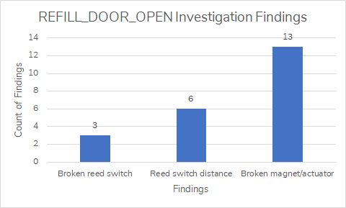
Current Impact: Refill Box Hardware
Components affected:
Reed switch
Actuator/Magnet
Refill Door

Slide 7

Countermeasures

Slide 8
Countermeasures: Refill Box Hardware Handling
Avoid banging refill box door when opening & closing it:
Realign refill box door where necessary
Firmly press refill box door instead of banging

Slide 9
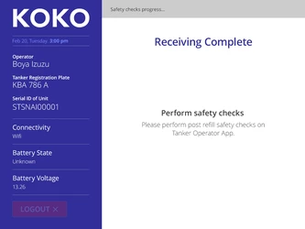
Countermeasures: Avoiding Hardware Error for Customers (Short-Term)
Confirm the KP’s internal refilling valves and refill box door have closed correctly by checking the screen on the KP changes to say ‘Receiving Complete’, and informs you to complete safety checks
If this screen is NOT displayed when the valves and door are CLOSED, take a photo of the screen and inform NOC of the issue
NOC member will then inform on next steps or take action as necessary

Slide 10
Dennis Chege

